Slide 1
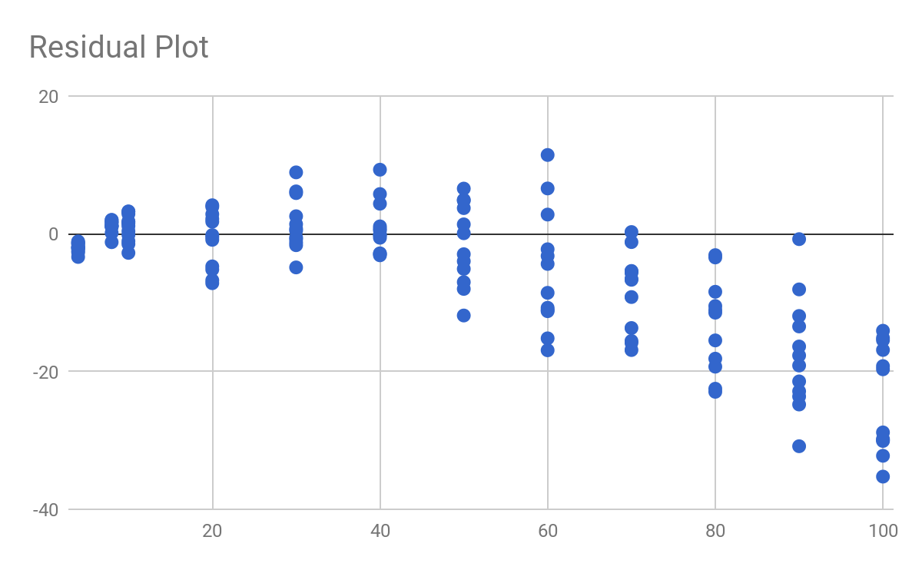
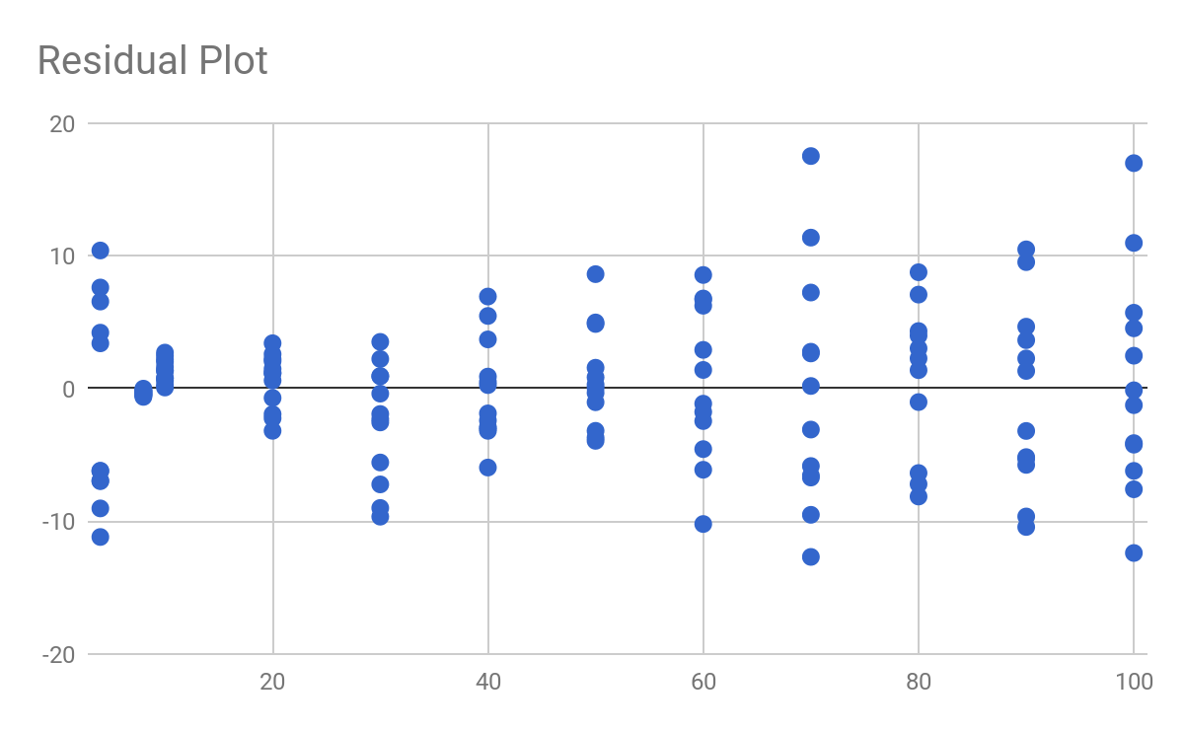
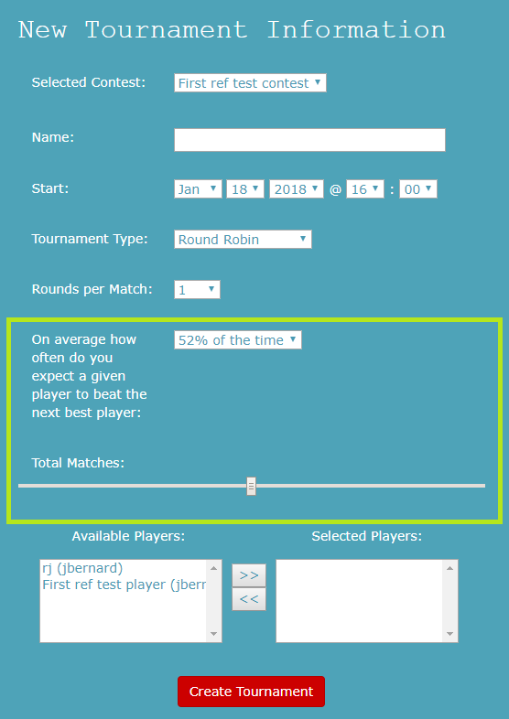
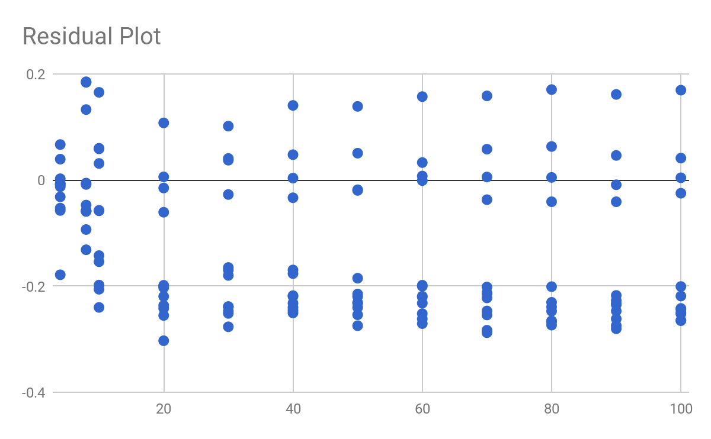
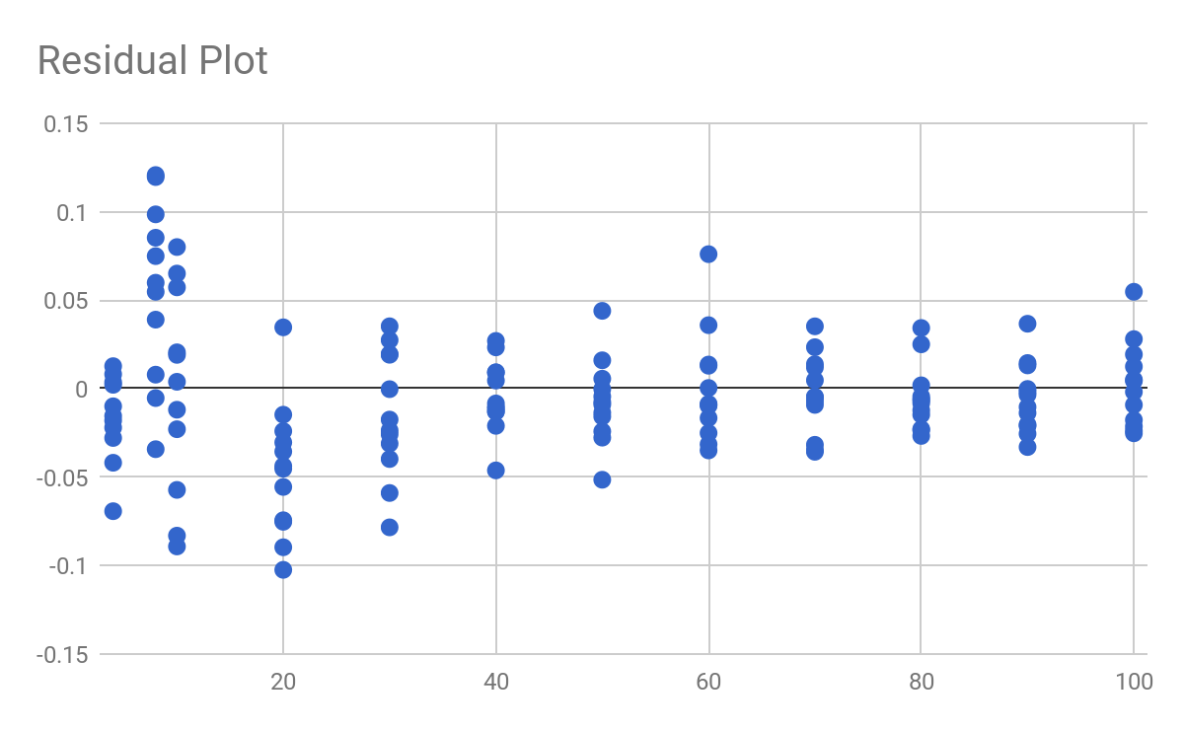


Overview
My team’s project was to extend competition software currently used by faculty here at Taylor to allow artificial intelligence competitions for games that require more than two players. Aside from the software, which could previously only host competitions for two player games, we were given a piece of code written by a Taylor alumnus that would simulate players competing in a tournament and attempt to figure out the rank of those players by how they performed.
Multiplayer Competition Analysis Jacob Bernard
Constructing software
Now that the formula had been found, I needed to implement the formula in software so that professors could control how their tournaments would operate. I implemented a simple slider and a few different inputs to gather information from the professor to help him or her make an effective decision about how many matches the tournament should run.
Our first Model for the equation for C was weak because the data shows a curved pattern
Our revised model for C shows a much healthier residual plot with no clear trends
Algorithm Analysis
First I needed to analyse the output of the simulation program to see if it would be robust enough to judge competitions quickly and fairly under numerous conditions. I put it through over one hundred tests to see how quickly it could reach a satisfying amount of certainty about how the various competitors ought to rank against each other. I found that the algorithm we were using could reduce uncertainty to a small fraction of the range of players acceptably quickly and decided to move forward.
The weight of points below the middle line of this residual shows that our first model for B was a bit weak
Although the points are messy on the left, as T grows, they stabilize, indicating that our revised model for B is strong
Creating a Model
Before we could integrate our successful algorithm into the current software, I had to find a way to generate accurate rankings without taking an inordinate amount of time. I decided to promote flexibility and usability by giving the decision to the creator of the competition about how to value time against certainty. This required finding a model that would appropriately predict the amount of certainty that the algorithm would hold towards the ranking of the players as a function of the various inputs it received. The rate at which uncertainty is reduced is dependant on a variety of factors, but I determined that the important inputs to isolate were the number of players in the competition(T), the number of players that would be involved in a single game(G), the skill disparity between the players(D), as well as the number of games played.
We had determined that uncertainty related to number of of games followed the model Uncertainty = C*NumberofGames^B, which is an equation known as the power law. What I needed to do then, was figure out how C and B varied as the other independent inputs changed. I made a number of hypotheses about the general relationship of the various inputs, such as the idea that as number of players increases, uncertainty would be higher. My team generated a bunch of graphs which helped confirm and improve upon those hypotheses and then it was up to me to turn those hypotheses into a model that fit the data. I predicted that the formula for C might resemble T + D + G and that the formula for B might be D/G-1/(TG).
Testing the Model
Once I had these models, I needed to prove that my models were correct or find a way to improve upon them. I put my models into nonlinear regression software to convert them into equations which had predictive power. I then took the prediction result generated by those equations and subtracted them from the actual results under each set of input conditions, generating the residuals. Using graphing software, I then generated residual plots to help analyse those formulas, looking for the residual plots to be scattered evenly about the midline. A scattered residual plot indicates that the prediction differs from the actual results in a consistent way, proving that the model is useful, while a residual plot with a clear trend or uneven scattering indicates that the predicted output vary from the actual data, proving that the model is weak.
The first models were shown to be a poor match for the actual data as they show observable variance from the data. I made continuous adaptations until I finally found models that had evenly scattered linear residual plots for both C and B. After looking at the terms, however, I recognised that there might be simpler representations of the models that would hold almost as much accuracy. I tried a few possible simplifications and finally found equations that were as simple as possible without losing necessary accuracy.
The highlighted section shows a prototype of my work on the front end
Conclusion
Finding a way to allow faculty to control how long to run their tournaments and understand the impact that would have on uncertainty of ranking was a difficult but rewarding problem. It required extensive investigations into mathematics and regression, and was one of the most difficult problems I have ever solved. I feel confident, however, that the model that we have now is an accurate prediction model and will benefit faculty and students for years to come
Acknowledgements
I’d like to acknowledge Dr. Geisler for his guidance and for his insight into formulas and mathematics
Final simplified equation. y = Uncertainty(RMSE) x = Number of games played

